Slide 1
MySQL Cluster
[NEC Group Internal Use Only]
OSS Technical Center
NEC Telecom Software Philippines

Slide 3
Table of Contents
Failure Detection
Communication Loss
Heartbeat Failure
Network Partitioning
Failure Scenarios
Storage Node Crash
SQL Node Crash
Connection Failure
Management Node Crash
Disk Failure

Slide 4
MySQL Cluster Investigation
Investigation Progress Report

Slide 5
MySQL Cluster: Failure Detection
There are two ways to detect failed nodes: communication loss and heartbeat failure. In both cases, a message is sent to all storage nodes and a network partitioning protocol is used to determine if there are enough nodes left to continue running the MySQL Cluster.
Note that if some nodes are reported as failed, it might in fact be the case that there are two parts of the cluster which have lost all connections between them. In this case, we can not allow both of them to stay alive, since this could cause database inconsistency.
MySQL Cluster ensures applications remain available using the network partitioning protocol to automatically selecting one part of the cluster which continues to execute. All nodes in the other part of the cluster are automatically restarted and connect to the cluster as new nodes.

Slide 6
MySQL Cluster: Failure Detection
Communication Loss
MySQL Cluster nodes are connected via different communication protocols. Currently TCP, Scalable Coherent Interface, OSE, and Shared Memory are all implemented and used. Normally, all storage nodes are connected with each other and every application nodes is connected with every storage node. (Except for shared memory, these connections can be used to connect nodes residing on different computers.)
If a storage node notices that a connection between two nodes is lost, then all other storage nodes are immediately informed and they jointly classify the node as failed. Failed nodes automatically restart and connect to the MySQL Cluster as a new node, leaving the application unaffected. Communication loss is the fastest way to detect that a node has failed.
Heartbeat Failure
There are also node failures which can not be detected by communication loss, e.g. disk problems, memory problems, and processor exhaustion. These failures cause a node to work improperly, but do not destroy the node connection to the rest of the MySQL Cluster. A heartbeat protocol is used to detect this kind of failure.

Slide 7
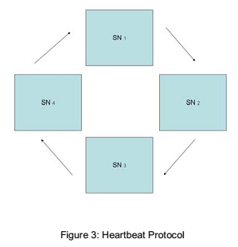
MySQL Cluster: Failure Detection (Heartbeat Failure cont..)
The storage nodes are organized in a logical circle(Figure 3.) Each storage node sends heartbeat signal to the next storage node in the circle. If a storage node fails to send three consecutive heartbeat signals, the next storage node will characterize the storage node as dead. The failed node is reported to all storage nodes, which jointly classify the node as failed.

Slide 8
MySQL Cluster: Failure Detection
Configuration File Parameters related to heartbeat failure detection
ndbd section
HeartbeatIntervalDbDb heartbeat messages interval between data nodes
HeartbeatIntervalDbApi heartbeat messages interval between data nodes and SQL nodes
HeartbeatOrder heartbeat messaging order; forwarding of heartbeat messages start from the node with the lowest heartbeat order value.
Example:
 | SN1 | SN2 | SN3 | SN4
HeartbeatOrder | 10 | 11 | 12 | 13
Flow of heartbeat message:
SN1 -> SN2 -> SN3 ->SN4 -> SN1

Slide 9
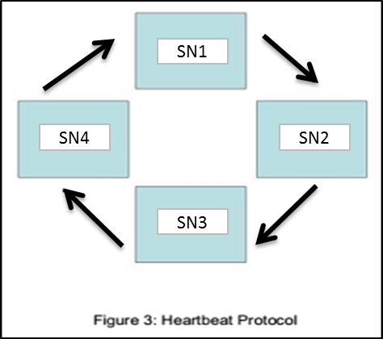
MySQL Cluster: Failure Detection
Network Partitioning
Whenever there are failed storage nodes, the remaining nodes use a network partitioning protocol to check whether they are in majority by having more than one node in each node group or by having more than half of the nodes available in each node group. This ensures that transactions are fully committed by eliminating the possibility that one node group acts alone and only commits part of the transactions.
To explain what could happen if no network partitioning protocol was implemented, consider a configuration with four storage nodes. Suppose all connections were lost between {SN1, SN3} and {SN2, SN4}. Since both sets are storing all partitions, each set has access to the whole database. If both sets were allowed to survive, then each set could update different information, thus leading us to two inconsistent databases.

Slide 10
MySQL Cluster: Failure Detection
The network partitioning protocol solves this problem by ensuring that a surviving set of storage nodes must be a majority of the storage nodes. In the particular case, where a surviving set of storage nodes are exactly half of the nodes an arbitrator is used to cast an extra vote.
For example, see images below and in the succeeding slides:
Environment Setup:
4 NDB (Data) Nodes
1 MGM Node
1 SQL Node

Slide 11
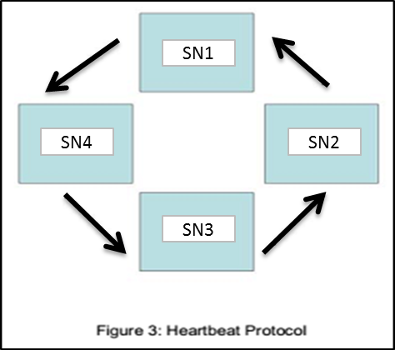
MySQL Cluster: Failure Detection
{SN1, SN3} nodes have no connection with {SN2, SN4} nodes. This making the environment having two sets of complete data which can cause a split-brain scenario (when cause of the communication failure is a network failure and not an actual node crash).
The lost of connection between the two sets will cause heartbeats to be missed by each node since heartbeats are sent in a logical circle.
When there is a network partitioning, the network partitioning protocol is launched on both sides of the split and it guarantees that, in the event of an even split, there will only be one running “cluster” remaining.
The arbitrator follows a simple rule: the first set of nodes to ask will be given a positive answer, and all other sets will be given a negative answer. IF a set of nodes cannot contact the arbitrator, they will shutdown automatically.
SN1 = 11
SN2 = 12
SN4 = 14
SN3 = 13
Node Group #0: SN1, SN2
Node Group #1: SN3, SN4

Slide 12
MySQL Cluster: Failure Detection

Slide 13
MySQL Cluster: Failure Detection

Slide 14
MySQL Cluster: Failure Detection

Slide 15
MySQL Cluster: Failure Detection
Log files to check.
In MGM node:
Found in the data directory created during installation of MySQL Cluster and set in config.ini configuration file DataDir parameter under [ndb_mgmd] section.
ndb_<cluster number>_cluster.log
In SQL node:
Found in the value set in local configuration file my.cnf log-error parameter.
mysqld.log
In NDBD node:
Found in the data directory created as specified in the global configuration file config.ini and is set using the DataDir parameter under [ndbd] section.
ndb_<ndb node id>_out.log
[ndb_mgmd]
# Management process options:
HostName=192.168.50.51 # Hostname or IP address of MGM node
DataDir=/var/lib/mysql-cluster # Directory for MGM node log files
ArbitrationRank=1
log-error=/var/log/mysqld.log
[ndbd]
# Options for data node "A":
# (one [ndbd] section per data node)
…# Node ID for this data node
DataDir=/var/lib/mysql-cluster # Directory for this data node's data files

Slide 16
MySQL Cluster: Failure Detection
Failure Scenarios
Storage Node Crash
If a storage node crashes, all other storage nodes are informed about this by loss of communication link between the nodes. For storage node crash, the crash scenario was simulated by the following:
Killing the ndbd process: kill <ndbd PID>
Shutting down of ndb node server: shutdown –h now
Sample logs when node crash is simulated:
Setup: 1 MGM, 2 SQL, 4 NDB
[SQL Node: mysqld.log]
[Other SQL Node: Log update(s) is the same with SQL Node 1.]
[NDB Node: ndb_10_out.log]
2017-05-26T07:32:32.302281Z 1 [Note] NDB Schema dist: Data node: 13 failed, subscriber bitmask 000000000
2017-06-16 19:49:29 [ndbd] INFO -- findNeighbours from: 5090 old (left: 12 right: 13) new (12 11)
2017-06-16 19:49:29 [ndbd] INFO -- NR Status: node=13,OLD=Restart completed,NEW=Node failed, fail handling ongoing
2017-06-16 19:49:29 [ndbd] INFO -- DBTC instance 0: Inserting failed node 13 into takeover queue, length now=1
2017-06-16 19:49:29 [ndbd] INFO -- DBTC instance 0: Removed node 13 from takeover queue, 0 failed nodes remaining
2017-06-16 19:49:29 [ndbd] INFO -- Adjusting disk write speed bounds due to : Node restart ongoing
2017-06-16 19:49:29 [ndbd] INFO -- NR Status: node=13,OLD=Node failed, fail handling ongoing,NEW=Node failure handling complete
2017-06-16 19:49:29 [ndbd] INFO -- Node 13 has completed node fail handling

Slide 17
MySQL Cluster: Failure Detection
[NDB Node: ndb_11_out.log]
[NDB Node: ndb_12_out.log]
[NDB Node: ndb_12_out.log]
2017-06-16 19:49:29 [ndbd] INFO -- findNeighbours from: 5090 old (left: 13 right: 12) new (10 12)
2017-06-16 19:49:29 [ndbd] ALERT -- Arbitration check won - node group majority
2017-06-16 19:49:29 [ndbd] INFO -- President restarts arbitration thread [state=6]
2017-06-16 19:49:29 [ndbd] INFO -- NR Status: node=13,OLD=Restart completed,NEW=Node failed, fail handling ongoing
2017-06-16 19:49:29 [ndbd] INFO -- DBTC instance 0: Starting take over of node 13
execGCP_NOMORETRANS(90300/13) c_ongoing_take_over_cnt -> seize
2017-06-16 19:49:29 [ndbd] INFO -- DBTC instance 0: Completed take over of failed node 13
completing gcp 90300/13 in execTAKE_OVERTCCONF
2017-06-16 19:49:29 [ndbd] INFO -- NR Status: node=13,OLD=Node failed, fail handling ongoing,NEW=Node failure handling complete
2017-06-16 19:49:29 [ndbd] INFO -- Node 13 has completed node fail handling
2017-06-16 19:49:30 [ndbd] INFO -- Adjusting disk write speed bounds due to : Node restart ongoing
2017-06-16 19:49:30 [ndbd] INFO -- findNeighbours from: 5090 old (left: 11 right: 10) new (11 10)
2017-06-16 19:49:30 [ndbd] INFO -- NR Status: node=13,OLD=Restart completed,NEW=Node failed, fail handling ongoing
start_resend(1, empty bucket (90300/13 90300/12) -> active
2017-06-16 19:49:30 [ndbd] INFO -- DBTC instance 0: Inserting failed node 13 into takeover queue, length now=1
2017-06-16 19:49:30 [ndbd] INFO -- DBTC instance 0: Removed node 13 from takeover queue, 0 failed nodes remaining
2017-06-16 19:49:30 [ndbd] INFO -- NR Status: node=13,OLD=Node failed, fail handling ongoing,NEW=Node failure handling complete
2017-06-16 19:49:30 [ndbd] INFO -- Node 13 has completed node fail handling
2017-06-16 19:49:30 [ndbd] INFO -- Adjusting disk write speed bounds due to : Node restart ongoing
2017-06-16 19:49:29 [ndbd] INFO -- Received signal 15. Performing stop.
2017-06-16 19:49:29 [ndbd] INFO -- The data node run-time environment has been stopped
2017-06-16 19:49:29 [ndbd] INFO -- Shutdown initiated
2017-06-16 19:49:29 [ndbd] INFO -- Shutdown completed - exiting
2017-06-16 19:49:30 [ndbd] INFO -- Angel shutting down
2017-06-16 19:49:30 [ndbd] INFO -- Node 13: Node shutdown completed. Initiated by signal 15.

Slide 18
MySQL Cluster: Failure Detection
[MGM Node: ndb_1_cluster.log]
2017-06-16 19:30:40 [MgmtSrvr] INFO -- Node 13: Node shutdown completed. Initiated by signal 15.
2017-06-16 19:30:40 [MgmtSrvr] ALERT -- Node 1: Node 13 Disconnected
2017-06-16 19:30:40 [MgmtSrvr] ALERT -- Node 10: Node 13 Disconnected
2017-06-16 19:30:40 [MgmtSrvr] INFO -- Node 10: Communication to Node 13 closed
2017-06-16 19:30:40 [MgmtSrvr] INFO -- Node 10: NR Status: node=13,OLD=Restart completed,NEW=Node failed, fail handling ongoing
2017-06-16 19:30:40 [MgmtSrvr] INFO -- Node 11: Communication to Node 13 closed
2017-06-16 19:30:40 [MgmtSrvr] ALERT -- Node 11: Arbitration check won - node group majority
2017-06-16 19:30:40 [MgmtSrvr] INFO -- Node 11: President restarts arbitration thread [state=6]
2017-06-16 19:30:40 [MgmtSrvr] INFO -- Node 11: NR Status: node=13,OLD=Restart completed,NEW=Node failed, fail handling ongoing
2017-06-16 19:30:40 [MgmtSrvr] ALERT -- Node 11: Node 13 Disconnected
2017-06-16 19:30:40 [MgmtSrvr] INFO -- Node 12: Communication to Node 13 closed
2017-06-16 19:30:40 [MgmtSrvr] INFO -- Node 12: NR Status: node=13,OLD=Restart completed,NEW=Node failed, fail handling ongoing
2017-06-16 19:30:40 [MgmtSrvr] ALERT -- Node 12: Node 13 Disconnected
2017-06-16 19:30:40 [MgmtSrvr] INFO -- Node 10: NR Status: node=13,OLD=Node failed, fail handling ongoing,NEW=Node failure handling complete
2017-06-16 19:30:40 [MgmtSrvr] INFO -- Node 11: NR Status: node=13,OLD=Node failed, fail handling ongoing,NEW=Node failure handling complete
2017-06-16 19:30:40 [MgmtSrvr] INFO -- Node 12: NR Status: node=13,OLD=Node failed, fail handling ongoing,NEW=Node failure handling complete
2017-06-16 19:30:43 [MgmtSrvr] INFO -- Node 11: Communication to Node 13 opened
2017-06-16 19:30:43 [MgmtSrvr] INFO -- Node 12: Communication to Node 13 opened
2017-06-16 19:30:44 [MgmtSrvr] INFO -- Node 10: Communication to Node 13 opened

Slide 19
MySQL Cluster: Failure Detection
SQL Node Crash
In the event of a SQL node crash, the management node (and other SQL nodes) is notified of the loss and logs appropriately. There is no activity (no log udpates detected), however, on any storage node. For SQL node crash, the crash scenario was simulated by the following:
Killing the ndbd process: kill <mysqld PID>
Shutting down of ndb node server: shutdown –h now
Sample logs when node crash is simulated:
Setup: 1 MGM, 2 SQL, 4 NDB
[SQL Node: mysqld.log; this node is the other SQL node running in the cluster]
[MGM Node: ndb_1_cluster.log]
2017-06-08T18:06:37.652758Z 1 [Note] NDB Schema dist: Data node: 10 reports unsubscribe from node 60, subscriber bitmask 2000000000000000
2017-06-08T18:06:37.652846Z 1 [Note] NDB Schema dist: Data node: 13 reports unsubscribe from node 60, subscriber bitmask 2000000000000000
2017-06-08T18:06:37.652854Z 1 [Note] NDB Schema dist: Data node: 12 reports unsubscribe from node 60, subscriber bitmask 2000000000000000
2017-06-08T18:06:37.652859Z 1 [Note] NDB Schema dist: Data node: 11 reports unsubscribe from node 60, subscriber bitmask 2000000000000000
2017-06-14 17:01:47 [MgmtSrvr] ALERT -- Node 10: Node 60 Disconnected
2017-06-14 17:01:47 [MgmtSrvr] INFO -- Node 10: Communication to Node 60 closed
2017-06-14 17:01:47 [MgmtSrvr] INFO -- Node 11: Communication to Node 60 closed
2017-06-14 17:01:47 [MgmtSrvr] ALERT -- Node 11: Node 60 Disconnected
2017-06-14 17:01:47 [MgmtSrvr] ALERT -- Node 12: Node 60 Disconnected
2017-06-14 17:01:47 [MgmtSrvr] INFO -- Node 12: Communication to Node 60 closed
2017-06-14 17:01:47 [MgmtSrvr] INFO -- Node 13: Communication to Node 60 closed
2017-06-14 17:01:47 [MgmtSrvr] ALERT -- Node 13: Node 60 Disconnected
2017-06-14 17:01:50 [MgmtSrvr] INFO -- Node 11: Communication to Node 60 opened
2017-06-14 17:01:50 [MgmtSrvr] INFO -- Node 12: Communication to Node 60 opened
2017-06-14 17:01:50 [MgmtSrvr] INFO -- Node 13: Communication to Node 60 opened
2017-06-14 17:01:51 [MgmtSrvr] INFO -- Node 10: Communication to Node 60 opened

Slide 20
MySQL Cluster: Failure Detection
Connection Failure
Connection failure scenario is when a node has lost network connection with the cluster. This scenario was simulated by the following:
Dropping packets received from other nodes: iptables –I INPUT –s <network address> -i <interface name> -j DROP
Shutdown interface: ifdown <interface name>
Sample logs when an NDB node lost its network connection with the cluster:
Setup: 1 MGM, 2 SQL, 2 NDB
[MGM Node: ndb_1_cluster.log]
2017-06-19 00:55:30 [MgmtSrvr] WARNING -- Node 3: Node 1 missed heartbeat 2
2017-06-19 00:55:30 [MgmtSrvr] WARNING -- Node 3: Node 4 missed heartbeat 2
2017-06-19 00:55:30 [MgmtSrvr] WARNING -- Node 3: Node 5 missed heartbeat 2
2017-06-19 00:55:33 [MgmtSrvr] WARNING -- Node 3: Node 1 missed heartbeat 3
2017-06-19 00:55:33 [MgmtSrvr] WARNING -- Node 3: Node 4 missed heartbeat 3
2017-06-19 00:55:33 [MgmtSrvr] WARNING -- Node 3: Node 5 missed heartbeat 3
2017-06-19 00:55:33 [MgmtSrvr] ALERT -- Node 1: Node 3 Disconnected
2017-06-19 00:55:36 [MgmtSrvr] WARNING -- Node 2: Node 3 missed heartbeat 2
2017-06-19 00:55:41 [MgmtSrvr] WARNING -- Node 2: Node 3 missed heartbeat 3
2017-06-19 00:55:46 [MgmtSrvr] WARNING -- Node 2: Node 3 missed heartbeat 4
2017-06-19 00:55:46 [MgmtSrvr] ALERT -- Node 2: Node 3 declared dead due to missed heartbeat
2017-06-19 00:55:46 [MgmtSrvr] INFO -- Node 2: Communication to Node 3 closed
2017-06-19 00:55:46 [MgmtSrvr] ALERT -- Node 2: Network partitioning - arbitration required
2017-06-19 00:55:46 [MgmtSrvr] INFO -- Node 2: President restarts arbitration thread [state=7]
2017-06-19 00:55:46 [MgmtSrvr] ALERT -- Node 2: Arbitration won - positive reply from node 1
2017-06-19 00:55:46 [MgmtSrvr] INFO -- Node 2: NR Status: node=3,OLD=Initial state,NEW=Node failed, fail handling ongoing
2017-06-19 00:55:46 [MgmtSrvr] INFO -- Node 2: LCP Take over started

Slide 21
MySQL Cluster: Failure Detection
Management Node Crash
Since the storage and MySQL Server nodes are not dependent on the management server for their execution, the management server may fail and be restarted any number of times without affecting the running MySQL Cluster.
Consequences of management node crash during runtime
continued operation of the cluster is not dependent on the management node, so the other running nodes in the cluster is not affected
If the management server is down, other nodes that were up when it failed will continue to be the cluster.
The management server needs to be up for nodes to join the cluster though, so if management node crashes, new nodes cannot join the cluster
Log files
To check for management node crash via log file, check the following log files:
MGM Node: ndb_node_id_cluster.log
NDB Node: ndb_node_id_out.log
It is also possible to check for management node crash via ndbinfo database.
If management node is set as arbitrator, the following tables in the ndbinfo can be checked
Table: arbitrator_validity_detail, arbitrator_validity_summary

Slide 22
MySQL Cluster: Failure Detection
Checking the logs for Management Node crash
When “Network failure or connection issue” occurs in MGM Node
Environment Setup: 1 MGM Node
In all ndb nodes, when mgm node is lost, the following is logged in ndb_<nodeid>_out.log
In mgm node, that lost its network connection to other nodes in the cluster, the following is logged:
Environment Setup: 2 MGM Nodes
In all ndb nodes, when mgm node is lost, the following is logged in ndb_<nodeid>_out.log
2017-05-25 15:44:30 [ndbd] INFO -- Lost arbitrator node 1 - process failure [state=6]
2017-05-25 16:36:04 [ndbd] INFO -- President restarts arbitration thread [state=1] >> (1)
2017-05-25 16:37:04 [ndbd] WARNING -- Could not find an arbitrator, cluster is not partition-safe >> (1)
(1) Only logged in president ndb node.
2017-05-25 16:05:53 [MgmtSrvr] ALERT -- Node 1: Node 11 Disconnected
2017-05-25 16:05:53 [MgmtSrvr] ALERT -- Node 1: Node 12 Disconnected
2017-05-25 16:05:53 [MgmtSrvr] ALERT -- Node 1: Node 13 Disconnected
2017-05-25 16:05:53 [MgmtSrvr] ALERT -- Node 1: Node 14 Disconnected
Since MGM node is disconnected from the cluster, it can no longer communicate with other nodes.
2017-05-25 15:44:30 [ndbd] INFO -- Lost arbitrator node 1 - process failure [state=6]
2017-05-25 16:36:04 [ndbd] INFO -- President restarts arbitration thread [state=1] >> (1)
2017-05-25 18:28:35 [ndbd] INFO -- Started arbitrator node 2 [ticket=12500002453dc4d1] >> (1)
(1) Only logged in president ndb node.

Slide 23
MySQL Cluster: Failure Detection
In mgm node (2), that lost its network connection to other nodes in the cluster, the following is logged:
In mgm node (1), that lost its network connection to other nodes in the cluster, the following is logged:
2017-06-27 00:15:30 [MgmtSrvr] INFO -- Node 11: Communication to Node 1 closed
2017-06-27 00:15:30 [MgmtSrvr] INFO -- Node 11: Lost arbitrator node 1 - process failure [state=6]
2017-06-27 00:15:30 [MgmtSrvr] INFO -- Node 11: President restarts arbitration thread [state=1]
2017-06-27 00:15:30 [MgmtSrvr] INFO -- Node 12: Communication to Node 1 closed
2017-06-27 00:15:30 [MgmtSrvr] INFO -- Node 12: Lost arbitrator node 1 - process failure [state=6]
2017-06-27 00:15:30 [MgmtSrvr] INFO -- Node 13: Communication to Node 1 closed
2017-06-27 00:15:30 [MgmtSrvr] INFO -- Node 13: Lost arbitrator node 1 - process failure [state=6]
2017-06-27 00:15:30 [MgmtSrvr] ALERT -- Node 14: Node 1 Disconnected
2017-06-27 00:15:30 [MgmtSrvr] INFO -- Node 14: Communication to Node 1 closed
2017-06-27 00:15:30 [MgmtSrvr] INFO -- Node 14: Lost arbitrator node 1 - process failure [state=6]
2017-06-27 00:15:30 [MgmtSrvr] ALERT -- Node 11: Node 1 Disconnected
2017-06-27 00:15:30 [MgmtSrvr] ALERT -- Node 12: Node 1 Disconnected
2017-06-27 00:15:30 [MgmtSrvr] ALERT -- Node 13: Node 1 Disconnected
2017-06-27 00:15:30 [MgmtSrvr] ALERT -- Node 2: Node 1 Disconnected
2017-06-27 00:15:30 [MgmtSrvr] INFO -- Node 12: Prepare arbitrator node 2 [ticket=12500002453dc4d1]
2017-06-27 00:15:30 [MgmtSrvr] INFO -- Node 13: Prepare arbitrator node 2 [ticket=12500002453dc4d1]
2017-06-27 00:15:30 [MgmtSrvr] INFO -- Node 14: Prepare arbitrator node 2 [ticket=12500002453dc4d1]
2017-06-27 00:15:30 [MgmtSrvr] INFO -- Node 11: Communication to Node 1 opened
2017-06-27 00:15:30 [MgmtSrvr] INFO -- Node 12: Communication to Node 1 opened
2017-06-27 00:15:30 [MgmtSrvr] INFO -- Node 13: Communication to Node 1 opened
2017-06-27 00:15:30 [MgmtSrvr] INFO -- Node 11: Started arbitrator node 2 [ticket=12500002453dc4d1]
2017-06-27 00:15:30 [MgmtSrvr] INFO -- Node 14: Communication to Node 1 opened
Since MGM node 1 is disconnected from the cluster, which is the arbitrator node, MGM node 2 was elected as the new arbitrator node.
Nothing is logged since the process responsible for logging is killed.

Slide 24
MySQL Cluster: Failure Detection
When ndb_mgmd process crashes (simulated by killing the process, abnormal termination)
Environment Setup: 1 MGM Node
In all ndb nodes, when mgm node is lost, the following is logged in ndb_<nodeid>_out.log
In mgm node, that lost its network connection to other nodes in the cluster, the following is logged:
Environment Setup: 2 MGM Nodes
In all ndb nodes, when mgm node is lost, the following is logged in ndb_<nodeid>_out.log
In mgm node, that lost its network connection to other nodes in the cluster, the following is logged:
2017-05-25 15:44:30 [ndbd] INFO -- Lost arbitrator node 1 - process failure [state=6]
2017-05-25 16:36:04 [ndbd] INFO -- President restarts arbitration thread [state=1] >> (1)
2017-05-25 16:37:04 [ndbd] WARNING -- Could not find an arbitrator, cluster is not partition-safe >> (1)
(1) Only logged in president ndb node.
Nothing is logged since the process responsible for logging is killed.
2017-05-25 15:44:30 [ndbd] INFO -- Lost arbitrator node 1 - process failure [state=6]
2017-05-25 16:36:04 [ndbd] INFO -- President restarts arbitration thread [state=1] >> (1)
2017-05-25 18:28:35 [ndbd] INFO -- Started arbitrator node 2 [ticket=12500002453dc4d1] >> (1)
(1) Only logged in president ndb node.
Nothing is logged since the process responsible for logging is killed.

Slide 25
MySQL Cluster: Failure Detection
In mgm node (2), that has network connection to other nodes in the cluster, the following is logged:
2017-06-27 22:08:54 [MgmtSrvr] INFO -- Node 11: Started arbitrator node 1 [ticket=7e61000149f03768]
2017-06-27 22:08:54 [MgmtSrvr] INFO -- Node 12: Node 51: API mysql-5.7.18 ndb-7.5.6
2017-06-27 22:08:54 [MgmtSrvr] INFO -- Node 11: Node 51 Connected
2017-06-27 22:08:54 [MgmtSrvr] INFO -- Node 11: Node 51: API mysql-5.7.18 ndb-7.5.6
2017-06-27 22:08:54 [MgmtSrvr] INFO -- Node 13: Node 51 Connected
2017-06-27 22:08:54 [MgmtSrvr] INFO -- Node 13: Node 51: API mysql-5.7.18 ndb-7.5.6
2017-06-27 22:08:54 [MgmtSrvr] INFO -- Node 14: Node 51 Connected
2017-06-27 22:08:54 [MgmtSrvr] INFO -- Node 14: Node 51: API mysql-5.7.18 ndb-7.5.6
2017-06-27 22:11:02 [MgmtSrvr] ALERT -- Node 11: Node 1 Disconnected
2017-06-27 22:11:02 [MgmtSrvr] INFO -- Node 11: Communication to Node 1 closed
2017-06-27 22:11:02 [MgmtSrvr] INFO -- Node 11: Lost arbitrator node 1 - process failure [state=6]
2017-06-27 22:11:02 [MgmtSrvr] INFO -- Node 11: President restarts arbitration thread [state=1]
2017-06-27 22:11:02 [MgmtSrvr] INFO -- Node 12: Communication to Node 1 closed
2017-06-27 22:11:02 [MgmtSrvr] INFO -- Node 13: Communication to Node 1 closed
2017-06-27 22:11:02 [MgmtSrvr] ALERT -- Node 13: Node 1 Disconnected
2017-06-27 22:11:02 [MgmtSrvr] INFO -- Node 14: Communication to Node 1 closed
2017-06-27 22:11:02 [MgmtSrvr] ALERT -- Node 14: Node 1 Disconnected
2017-06-27 22:11:02 [MgmtSrvr] ALERT -- Node 12: Node 1 Disconnected
2017-06-27 22:11:02 [MgmtSrvr] ALERT -- Node 2: Node 1 Disconnected
2017-06-27 22:11:02 [MgmtSrvr] INFO -- Node 12: Communication to Node 1 opened
2017-06-27 22:11:02 [MgmtSrvr] INFO -- Node 13: Communication to Node 1 opened
2017-06-27 22:11:02 [MgmtSrvr] INFO -- Node 11: Communication to Node 1 opened
2017-06-27 22:11:02 [MgmtSrvr] INFO -- Node 12: Prepare arbitrator node 2 [ticket=7e61000249f22df6]
2017-06-27 22:11:02 [MgmtSrvr] INFO -- Node 13: Prepare arbitrator node 2 [ticket=7e61000249f22df6]
2017-06-27 22:11:02 [MgmtSrvr] INFO -- Node 14: Prepare arbitrator node 2 [ticket=7e61000249f22df6]
2017-06-27 22:11:03 [MgmtSrvr] INFO -- Node 14: Communication to Node 1 opened
2017-06-27 22:11:03 [MgmtSrvr] INFO -- Node 11: Started arbitrator node 2 [ticket=7e61000249f22df6]

Slide 26
MySQL Cluster: Failure Detection
Checking the ndbinfo database for Management Node crash
If the management node is the arbitrator (which is, by default), then validity of the arbitrator can be checked in the arbitrator_validity_detail and arbitrator_validity_summary tables in the ndbinfo database.
mysql> select * from arbitrator_validity_detail;
+---------+------------+------------------+---------------+-----------+
| node_id | arbitrator | arb_ticket | arb_connected | arb_state |
+---------+------------+------------------+---------------+-----------+
| 11 | 2 | 12500002453dc4d1 | Yes | ARBIT_RUN |
| 12 | 2 | 12500002453dc4d1 | Yes | ARBIT_RUN |
| 13 | 2 | 12500002453dc4d1 | Yes | ARBIT_RUN |
| 14 | 2 | 12500002453dc4d1 | Yes | ARBIT_RUN |
+---------+------------+------------------+---------------+-----------+
Connection status of management node to data nodes
NodeId of management node that acts as the arbitrator
mysql> select * from arbitrator_validity_detail;
+---------+------------+------------------+---------------+------------+
| node_id | arbitrator | arb_ticket | arb_connected | arb_state |
+---------+------------+------------------+---------------+------------+
| 11 | 0 | 12500003457f27eb | No | ARBIT_FIND |
| 12 | 0 | 12500002453dc4d1 | No | ARBIT_NULL |
| 13 | 0 | 12500002453dc4d1 | No | ARBIT_NULL |
| 14 | 0 | 12500002453dc4d1 | No | ARBIT_NULL |
+---------+------------+------------------+---------------+------------+
ARBIT_FIND state for president ndb node (President ndb node is looking for the arbitrator node)
ARBIT_NULL state for non-president ndb nodes which means arbitrator node is not found

Slide 27
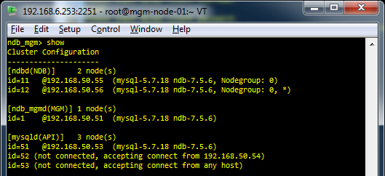
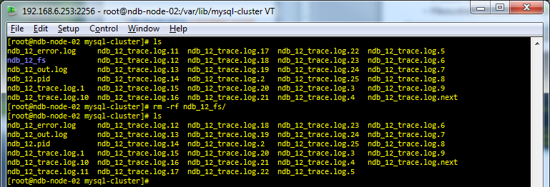
MySQL Cluster: Failure Detection
Disk Failure
All storage nodes store their own data. If a node detects that its file system has become corrupted, it stops executing. After the filesystem has been cleared, the node is restarted using the node recovery protocol.
Example:
2 Data Nodes (1 Node Group) Running
Filesystem Directory corrupted in Node #12 (Removed/Deleted directory to simulate Disk Failure)
2 ndb nodes running
MGM Node
Filesystem directory exists
2 ndb nodes running
Filesystem directory removed/deleted
NDB Node

Slide 28
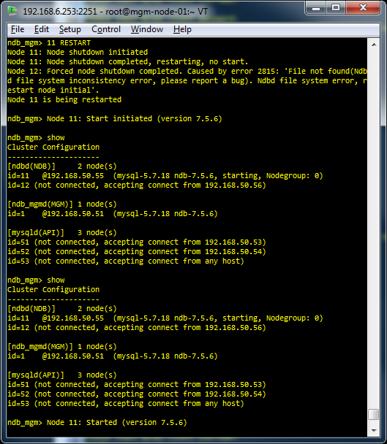
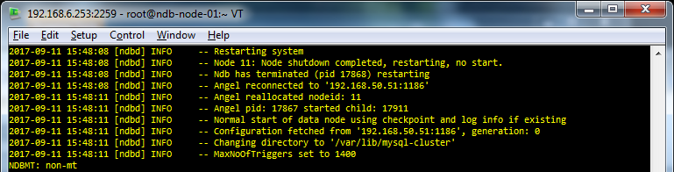
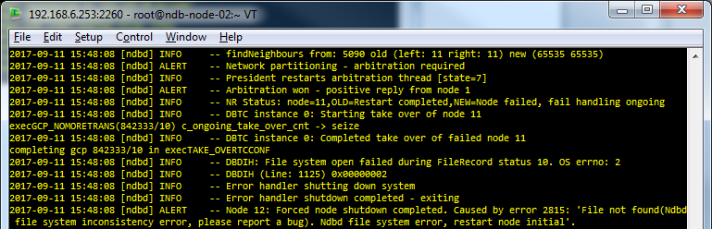
MySQL Cluster: Failure Detection
MGMNode
Node 11 was restarted, this will trigger the Cluster to use the Data in Node 12.
When Node 11 was restarted, the cluster attempts to elect Node 12 to be the source of the data, however, the cluster detects error in Fie system.
Due to the error detected, Node 12 was terminated.
Node 11 was restarted, this will trigger the Cluster to use the Data in Node 12.
the Data in Node 12.
Node 11 was restarted, this will trigger the Cluster to use the Data in Node 12.
NDB Node

Slide 29
MySQL Cluster: Failure Detection
Node 12 was terminated due to file system corruption.
MGMNode

